Slide 1
Primary Battery

Slide 2
Battery types
Alkaline
nickel metal hydride (NIMH) (lasts longer)
lithium ion
Ni-cd
Li-po

Slide 3
Alkaline
has an alkaline electrolyte of potassium hydroxide (KOH)
lithium (Li), sodium (Na), potassium (K), rubidium (Rb), caesium (Cs), and francium (Fr)
Alkaline batteries account for 80% of manufactured batteries in the US
Better than zinc–carbon battery (longer shelf life and higher energy density)

Slide 4
Ni-cd
Very boomer tech (1899)
arger ventilated wet cell Ni-Cd batteries are used in emergency lighting, standby power, and uninterruptible power supplies and other applications.

Slide 5
nickel metal hydride
Lasts longer
rechargeable battery
chemical reaction at the positive electrode is similar to that of the NiCd
have two to three times the capacity of NiCd + higher energy density
used as a substitute for similarly shaped non-rechargeable alkaline batteries

Slide 6
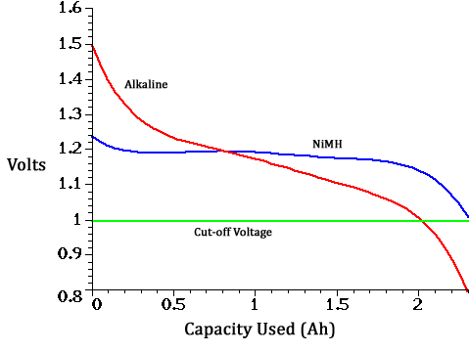

Slide 7
Li-ION
have a high energy density, no memory effect and low self-discharge
Lithium-ion batteries are commonly used for portable electronics and electric vehicles and are growing in popularity for military and aerospace applications.
Boomer tech (1985)

Slide 8
Li-po
lithium-ion technology using a polymer electrolyte instead of a liquid electrolyte.
mobile devices, radio-controlled aircraft and some electric vehicles

